Slide 1

gQ` ]\
RV College of Engineering
Go, change the world
DEVELOPMENT OF CUSTOM APPLICATION FOR PRODUCT LIFECYCLE MANAGEMENT
1RV21MC067
Nithin
Under the Guidance
of
Internal Guide : External Guide :
Dr. S Anupama Kumar, Mr. Amith kumar sharma,
Associate Professor, PLM Developer,
RV College of Engineering , Bengaluru. KOCH Business Solutions , India.
Department of MCA, RVCE

Slide 2

Go, change the world
RV College of
Engineering
Agenda
Introduction
Literature Survey
Objectives of the Project Work
Proposed Methodology
Tools and Technologies Used
Hardware and Software Requirements
Software Requirement Specifications
Implementation
Testing
Conclusion
References

Slide 3
Go, change the world
RV College of
Engineering
Introduction
The problem identified for the development of the PLM application is the lack of an efficient and comprehensive system to manage the entire product lifecycle.
Existing processes often involve manual and disconnected methods, leading to inefficiencies, errors, and delays in product development, as well as difficulties in collaboration and data management.
The domain of work for the PLM application encompasses product lifecycle management across various industries and sectors.
It caters to organizations involved in designing, engineering. manufacturing, and marketing of products, spanning from consumer goods to industrial machinery, electronics, automotive, and more.

Slide 4
Literature Survey
Go, change the world
S No | Author and Paper title | Details of Publication | Summary of the Paper
1 | Title : Exploring the Basic Features and Challenges of Traditional Product Lifecycle Management Systems[1] Author: M. Hayat; H. Winkler | IEEE International Conference on Industrial Engineering and Engineering Management (IEEM) 2022 https://ieeexplore.ieee.org/abstract/document/9989978 | This study analyzed that most of the existing PLMs do not contain all the required features and therefore, industries usually integrate different software to make a full-fledged PLM system. However, this practice results in reducing the overall system efficiency.
2 | Title: Selection of product lifecycle management components based on AHP methodologies Author: Haiqing Zhang; Yacine Ouzrout; Abdelaziz Bouras; Vincenzo Della Selva; Matteo Mario Savino | International Conference on Advanced Logistics and Transport 2022 https://ieeexplore.ieee.org/document/6568513 | In this paper framework called TIFOS (TechnoWare, InforWare, FunctionWare, OrgaWare, SustainWare) to collect these main PLM components. The paper also provides a development approach based on the Analytical Hierarchy Process (AHP) method to better handle these components.
3 | Title: Research on PLM multidimensional data model Author: Zhen Wang; Lifeng Wang; Yuxiang Rui; Congxin Li | International Technology and Innovation Conference 2022 https://ieeexplore.ieee.org/document/4752242 | Through analyzing on the product structure and production process of manufacturing enterprises, this paper points out that the traditional BOM data model, owing to its own limitation, can no longer meet the need of PLM. The only way for enterprises to walk out the dilemma of manufacturing information is finding out a proper product structure and production data model.

Slide 5
S No | Author and Paper title | Details of Publication | Summary of the Paper
4 | Title : A Web-based PLM system research and implementation in a collaborative product development environment[2] Author : Hai-yue Li; Xiao Liu; Guo-qi Feng; Cheng-en Wang | IEEE International Conference on e-Business Engineering (ICEBE’05) 2021 https://www.researchgate.net/publication/253341617_Collaborative_Product_Development_in_PLM_Multisite_Platform | A PLM prototype system is implemented based on B/S scheme and the proposed conceptual PLM system architecture, and primary ideas have been validated
5 | Title: Research on PLM System Architecture Model and Process.[3] Authors: Lin Gao,Jun Gao, Yangxi Fan, Jianqiang Zheng | WASE International Conference on Information Engineering Feb 2021 https://dl.acm.org/doi/abs/10.1109/ICIE.2009.129 | In this paper, function and architecture of product lifecycle management system are analyzed first. Then system model is established from point of view of application and development.

Slide 6
Go, change the world
RV College of
Engineering
Literature Survey
S No | Author and Paper title | Details of Publication | Summary of the Paper
6 | Title: Product Lifecycle Management Systems and Business Process Improvement – A Report on Case Study Research[4] Authors: Raul Brandao, Martin Wynn | The Third International Multi-Conference on Computing in the Global Information Technology Mar 2020 https://dl.acm.org/doi/10.1109/ICCGI.2008.48 | This paper explores the role of product life-cycle management (PLM) systems in industry by evaluating their impact on business process improvement. In addition, future trends of these systems are also analyzed.
7 | Title : Success determinants to Product Lifecycle Management (PLM) performance[5] Author : Shikha Singh; Subhas Chandra Misra | 5th International Conference on Industrial Engineering and Applications (ICIEA) July 2020 https://www.researchgate.net/publication/325853184_Success_determinants_to_Product_Lifecycle_Management_PLM_performance | Product Lifecycle Management (PLM) is a current need for companies to be competitive in the global market. PLM became a necessity to work collaboratively with least time and cost for the best quality production.
8 | Title: Research on Product Lifecycle Management system based on Teamcenter[6] Author : Yongxian Liu; Yu Zhang; Hualong Xie; Jian Qiu | Chinese Control and Decision Conference 2019 https://ieeexplore.ieee.org/abstract/document/4597606 | Teamcenter software is the leader in PLM solution field. Considering the actual demands about the informationization management in large, medium and small enterprises, three architectures of Teamcenter are illustrated, eight subsystems of Teamcenter are discussed in detail.

Slide 7
Go, change the world
Literature Survey
S No | Author and Paper title | Details of Publication | Summary of the Paper
9 | Title: Material Management in LCA Integrated PLM[7] Author : Jing Lin; Clotilde Rohleder; Selmin Nurcan | IEEE International Conference on Engineering, Technology and Innovation (ICE/ITMC) 2019 https://ieeexplore.ieee.org/document/8436374 | This paper describes research challenges using risk-based due diligence
10 | Title : Product lifecycle management and digital manufacturing technologies in the era of cloud computing[8] Author : Conor Holligan; Vincent Hargaden; Nikolaos Papakostas | International Conference on Engineering, Technology and Innovation (ICE/ITMC) 2018 https://www.researchgate.net/publication/322994986_Product_lifecycle_management_and_digital_manufacturing_technologies_in_the_era_of_cloud_computing | In this paper challenges are outlined and reviewed in the context of the novel technological developments that have started to emerge. At the same time, the potential application areas as well as the business opportunities, stemming from the deployment of more sophisticated PLM systems, are discussed.

Slide 8
Go, change the world
RV College of
Engineering
Summary of literature survey
The literature survey on PLM (Product Lifecycle Management) covers various aspects of PLM implementation, challenges, and benefits.
It explores the role of PLM in improving product development processes, collaboration, and innovation.
The survey highlights the importance of data management and integration within PLM systems to ensure accurate and up-to-date product information.
It discusses the challenges associated with PLM implementation, including organizational change management, system integration, and data migration.

Slide 9
Go, change the world
RV College of
Engineering
Objectives
Gathering the requirement for development of application, designing the system and designing the architecture.
Applying the Agile approach for developing the core module
Integration of the module and managing the data.
Testing the application and deployment

Slide 10
Go, change the world
RV College of
Engineering
Proposed Methodology
Requirements Gathering
System Design and Architecture
Agile Development Approach
Core Module Development
Integration and Data Management
User Interface and Experience
Testing and Quality Assurance
Deployment and User Training
Continuous Improvement and Maintenance

Slide 11
Go, change the world
RV College of
Engineering
List of Tools and Technologies
Java
Java SWT
JFace
Eclipse RPC
C/C++
Google Web Toolkit (GWT)
Angular JS
SQL

Slide 12
Go, change the world
RV College of
Engineering
Design Methodology
software Requirements:
Windows 10 Enterprise or Professional (64-bit only) version 20H2 or later
Or Windows 11 Enterprise or Professional version 21H2 or later
Internet Explorer 11
  Solid Edge, while not dependent on any other browser, has been certified against other modern and popular browsers like Google Chrome, Microsoft Edge, and Mozilla Firefox.
Microsoft Office 2019, 2021, and Microsoft Office 365 Business

Slide 13
Go, change the world
RV College of
Engineering
Design Methodology
Hardware Requirement:
Recommended system configuration
Windows 10 Enterprise or Professional (64-bit only) version 20H2 or later
9.0 GB of disk space required for installation (includes prerequisites)
32 GB RAM or more
True Color (32-bit) or 16 million colors (24-bit)
Screen Resolution: 1920 x 1080
Video RAM: 2GB
Minimum system configuration
Windows 10 Enterprise or Professional (64-bit only) version 20H2 or later
9.0 GB of disk space required for installation (includes prerequisites)
16 GB RAM for commercial users and 8 GB RAM for academic users
65K Colors
Screen Resolution: 1920 x 1080

Slide 14
Go, change the world
RV College of
Engineering
Software Requirement Specification
Document Management: This module facilitates the management of documents associated with product development, such as specifications, drawings, manuals, and other technical documents. It includes document check-in/check-out, review and approval workflows, document change management, and document search and retrieval functionalities.
CAD Integration: Teamcenter integrates with various computer-aided design (CAD) tools, allowing seamless integration between Teamcenter and CAD software for efficient management and synchronization of CAD files, metadata, and design revisions.
Quality Management: The Quality Management module provides functionalities for managing product quality throughout its lifecycle. It includes quality plan definition, inspections and audits, non-conformance tracking, corrective and preventive actions (CAPAs), and quality metrics tracking.
Reporting and Analytics: Teamcenter includes reporting and analytics capabilities for generating comprehensive reports, performance metrics, and analytics dashboards. These features provide insights into product data, process efficiency, project status, and other key performance indicators (KPIs) for informed decision-making.

Slide 15
Go, change the world
RV College of
Engineering
Software Requirement Specification
Module Name: Document Management
Purpose: The Document Management module in Custom PLM focuses on managing documents related to product development, such as specifications, drawings, manuals, and technical documents.
Input: The input for the Document Management module includes various types of documents created during the product development process
Function: The module facilitates document collaboration by providing capabilities for comment tracking, markups, and review workflows. It also includes search functionality, allowing users to locate documents based on attributes, keywords, or metadata.
Output: The module also generates document change notifications, approval records, and access logs, providing an audit trail of document-related activities.

Slide 16
Go, change the world
RV College of
Engineering
Software Requirement Specification
Module Name: Document Management
Purpose: The Document Management module in Custom PLM focuses on managing documents related to product development, such as specifications, drawings, manuals, and technical documents.
Input: The input for the Document Management module includes various types of documents created during the product development process
Function: The module facilitates document collaboration by providing capabilities for comment tracking, markups, and review workflows. It also includes search functionality, allowing users to locate documents based on attributes, keywords, or metadata.
Output: The module also generates document change notifications, approval records, and access logs, providing an audit trail of document-related activities.

Slide 17
Go, change the world
RV College of
Engineering
Software Requirement Specification
Module Name: CAD Integration
Purpose: The CAD Integration module in Custom PLM enables seamless integration between Teamcenter and various computer-aided design (CAD) tools.
Input: The input for the CAD Integration module includes CAD files and associated metadata created and modified using CAD software, such as Siemens NX .
Function: The module provides capabilities for managing CAD file relationships, associating CAD files with product structures, and synchronizing design changes between Teamcenter and the CAD software. It also supports visualization of CAD data, allowing users to view, interrogate, and analyze 3D models and drawings.
Output: The module generates CAD-related reports, visualizations, and metadata, supporting collaboration and decision-making during the product development process.

Slide 18
Go, change the world
RV College of
Engineering
Software Requirement Specification
Module Name: Quality Management
Purpose: The Quality Management module in Custom PLM focuses on managing product quality throughout its lifecycle.
Input: The input for the Quality Management module includes quality requirements, specifications, inspection plans, and non-conformance data.
Function: The Quality Management module allows users to define quality plans and requirements for products. It supports the creation and management of inspection plans, defining the criteria, methods, and frequency of inspections.
Output: The module generates quality reports, performance metrics, and audit records, enabling organizations to monitor and continuously improve their quality processes.

Slide 19
Go, change the world
RV College of
Engineering
Software Requirement Specification
Module Name: Reporting and Analytics
Purpose: The Reporting and Analytics module in Custom PLM provides capabilities for generating comprehensive reports, performance metrics, and analytics dashboards.
Input: The input for the Reporting and Analytics module includes data from various modules and sources within PLM Application, such as change management, quality management, manufacturing processes, or requirements management.
Function: The Reporting and Analytics module enables users to define and generate custom reports, tailored to specific requirements and key performance indicators (KPIs). It provides data visualization tools, including charts, graphs, and dashboards, to facilitate data analysis and interpretation
Output: The module enables data-driven decision-making, supports process optimization, and provides a basis for continuous improvement initiatives.

Slide 20
Go, change the world
RV College of
Engineering
Software Requirement Specification
Non-Functional Requirements:
Performance
The PLM system needs to be optimized from an application standpoint in order to provide effective and quick performance.
Scalability
The PLM solution must be scalable since it must be able to handle growing data and user loads over time. Scalability should be considered while designing the system so that it can expand and change to meet changing business requirements.
Security
As a PLM application deals with sensitive and private product-related information, security is of the highest significance.
Reliability
The PLM system must have excellent uptime and data retention standards, guaranteeing minimal downtime.

Slide 21
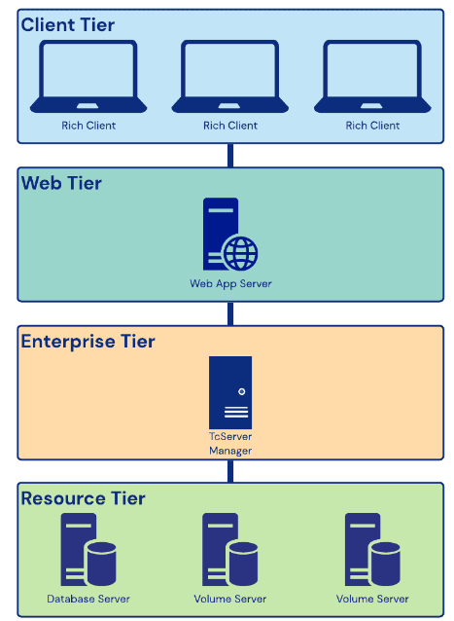
Go, change the world
RV College of
Engineering
Higher Level Design
Architectural diagram

Slide 22
Go, change the world
RV College of
Engineering
Higher Level Design
DFD LEVEL 0
Product ID
Product Name
Change Request,….
PLM Application
Product ID
Product Name
Product Design
0
Product Design & Document
User

Slide 23
Go, change the world
RV College of
Engineering
Higher Level Design
DFD LEVEL 1
Product ID ,
Specifications,
Drawings,
Manual,….
Document management
CAD Integration
Product ID
Product Name
Change Request,….
1
2
USER
CAD Reports, Visualization, Metadata
Quality reports, Performance metrics,
Audit records
Quality Management
3
Product Design
Report and Analytics

Slide 24
Go, change the world
RV College of
Engineering
Implementation
Module 1: Document Management
Input:
  Product-related documents such as design specifications, engineering drawings, user manuals, and compliance documents are input into the Document Management module. These documents can be uploaded by users or integrated from other systems. User inputs are received during document creation or modification processes, including document metadata (e.g., title, author, version), document relationships, and access control settings.
Process:
  Document Creation and Modification: The module includes functionalities to create new documents or modify existing ones. Users can input document content, attach files, and assign appropriate metadata.
  Version Control: The module ensures version control by maintaining a history of document changes, allowing users to access previous versions and track modifications.
  Access Control: User inputs are processed to define access permissions for documents, ensuring that only authorized individuals can view, edit, or delete specific documents.
  Document Search and Retrieval: The module's search functionality processes user queries and retrieves relevant documents based on keywords, document types, authors, and other specified criteria.
Output:
  Stored and Organized Documents: The output includes a well-organized repository of product-related documents accessible through the PLM application.
  Document Metadata and Version Information: Users receive outputs containing document metadata (e.g., title, author, creation date) and version details (e.g., version number, modification history).
  Search Results: Outputs present search results displaying relevant documents matching user queries.
  Access-Controlled Document Access: The module provides outputs indicating which users have access to view or modify specific documents.

Slide 25
Go, change the world
RV College of
Engineering
Implementation
Module 2: CAD Integration
Input:
  CAD Data Files: Users input CAD data files from various design software, such as AutoCAD or SolidWorks, into the PLM application.
  User Inputs: Users provide inputs during the CAD data import process, such as specifying import settings, desired file formats, and conversion options.
Process:
  CAD Data Import: The module processes user-provided CAD data files and imports them into the PLM system. The data is converted into a format compatible with the PLM application.
  CAD Data Visualization: The module enables users to visualize CAD designs directly within the PLM user interface, facilitating review and collaboration.
  Synchronization: The module ensures synchronization of design changes between the PLM system and CAD applications, enabling seamless updates to design data.
Output:
  Imported CAD Data: The output includes the successfully imported CAD data, integrated into the PLM application for further use.
  CAD Design Visualization: Users can access outputs displaying visualizations of CAD designs within the PLM user interface.
  Design Synchronization Status: Outputs provide notifications indicating the status of design synchronization between the PLM system and CAD applications.

Slide 26
Go, change the world
RV College of
Engineering
Implementation
Module 3: Quality Assurance
Input:
  Quality Test Results: Inputs to the Quality Assurance module include data from product quality tests and inspections conducted during the manufacturing process.
  User Inputs: Users provide inputs related to quality control checklists, inspection criteria, and non-conformance details.
Process:
  Recording Quality Test Results: The module processes data from quality tests and records the results, including pass/fail statuses and measurement data.
  Quality Inspections and Audits: The module manages quality inspections and audits, ensuring adherence to specified standards and procedures.
  Non-Conformance Management: User inputs are processed to identify and manage non-conformance issues, triggering corrective actions and resolution procedures.
Output:
  Recorded Quality Test Results: Outputs present comprehensive reports on quality test results, including pass/fail outcomes and measurement details.
  Compliance Status and Quality Metrics: Users receive outputs indicating compliance status and key quality control metrics for products.
  Non-Conformance Notifications: The module provides outputs notifying users of non-conformance issues, along with updates on corrective actions and resolution progress.

Slide 27
Go, change the world
RV College of
Engineering
Implementation
Module 4: Report and Analytics
Input:
  Product Data and Performance Metrics: Inputs include product-related data, performance metrics, and key performance indicators (KPIs) collected from various stages of the product lifecycle.
  User Inputs: Users provide inputs specifying report parameters, analytics preferences, and the selection of specific data for analysis.
Process:
  Customizable Report Template Creation: The module allows users to create customizable report templates to suit specific reporting needs and requirements.
  Data Aggregation and Analysis: Inputs are processed for data aggregation and analysis, enabling the generation of insights and trends.
  Visualization: The module processes user inputs to visualize analytical findings through charts, graphs, and interactive dashboards.
Output:
  Comprehensive Reports: Outputs present comprehensive reports based on user-selected templates, including data summaries and performance evaluations.
  Visualizations and Analytics Insights: Users receive outputs featuring visualizations and analytical insights, facilitating data-driven decision-making.
  Key Performance Indicators: The module provides outputs displaying key business metrics and performance indicators for products and processes.

Slide 28
Go, change the world
RV College of
Engineering
Unit Testing
Module 1: Document Management
Test Case ID | Description | Input | Expected Output | Actual Output | Remarks
DM-TC-001 | Document Creation - Valid details | Document details (title, author, version) | New document is created with provided details | New document created successfully | Pass
DM-TC-002 | Document Creation - Missing information | Incomplete document details | Appropriate error message is displayed | Error message displayed as expected | Pass
DM-TC-003 | Document Creation - Unique ID | N/A | Document ID is unique for each created document | Document ID is unique as expected | Fail
DM-TC-004 | Document Creation - Unique ID | N/A | Document ID is unique for each created document | Document ID is unique as expected | Pass

Slide 29
Go, change the world
RV College of
Engineering
Unit Testing
Module 2: CAD Integration
Test Case ID | Description | Input | Expected Output | Actual Output | Remarks
CAD-TC-001 | CAD Import - Valid CAD file | CAD file in supported format | CAD file is successfully imported | CAD file imported successfully | Pass
CAD-TC-002 | CAD Import - Invalid CAD file | CAD file in unsupported format | Appropriate error message is displayed | Error message displayed as expected | Fail
CAD-TC-002 | CAD Import - Invalid CAD file | CAD file in unsupported format | Appropriate error message is displayed | Error message displayed as expected | Pass
CAD-TC-003 | CAD Import - Metadata Update | Updated CAD file metadata | CAD file metadata is updated | Metadata updated successfully | Pass

Slide 30
Go, change the world
RV College of
Engineering
Unit Testing
Module 3: Quality Assurance
Test Case ID | Description | Input | Expected Output | Actual Output | Remarks
QA-TC-001 | Inspection Creation | Inspection details | New inspection is created | Inspection created successfully | Pass
QA-TC-002 | Audit Creation | Audit details | New audit is created | Audit created successfully | Fail
QA-TC-003 | Inspection Results | Inspection findings and results | Inspection results are recorded | Results recorded successfully | Pass
QA-TC-004 | Audit Creation | Audit details | New audit is created | Audit created successfully | Pass

Slide 31
Go, change the world
RV College of
Engineering
Unit Testing
Module 4: Report and Analytics
Test Case ID | Description | Input | Expected Output | Actual Output | Remarks
RA-TC-001 | Report Generation | Report criteria and parameters | Report is generated and displayed | Report generated successfully | Fail
RA-TC-002 | Report Generation | Report criteria and parameters | Report is generated and displayed | Report generated successfully | Pass
RA-TC-002 | Data Extraction | Data extraction parameters | Relevant data is extracted and available | Data extracted successfully | Pass
RA-TC-003 | Analysis and Visualization | Analysed data and visualization parameters | Analysis and visualization are generated | Analysis and visualization successful | Pass

Slide 32
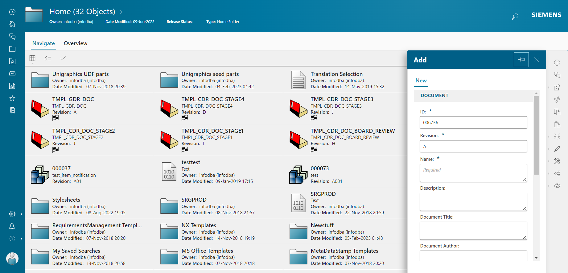
Go, change the world
RV College of
Engineering
Screen shots of Result
Document Management

Slide 33
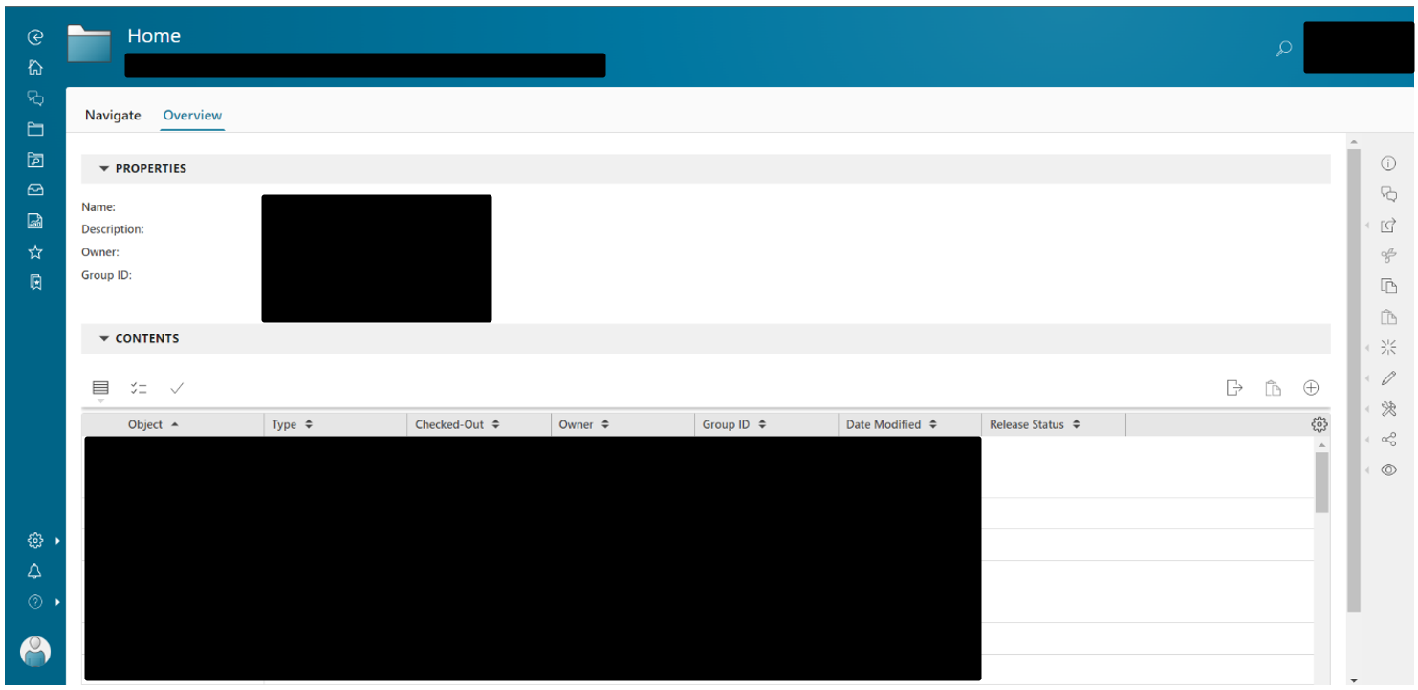
Go, change the world
RV College of
Engineering
Screen shots of Result
Document Management

Slide 34
Go, change the world
RV College of
Engineering
Screen shots of Result
Document Overview

Slide 35
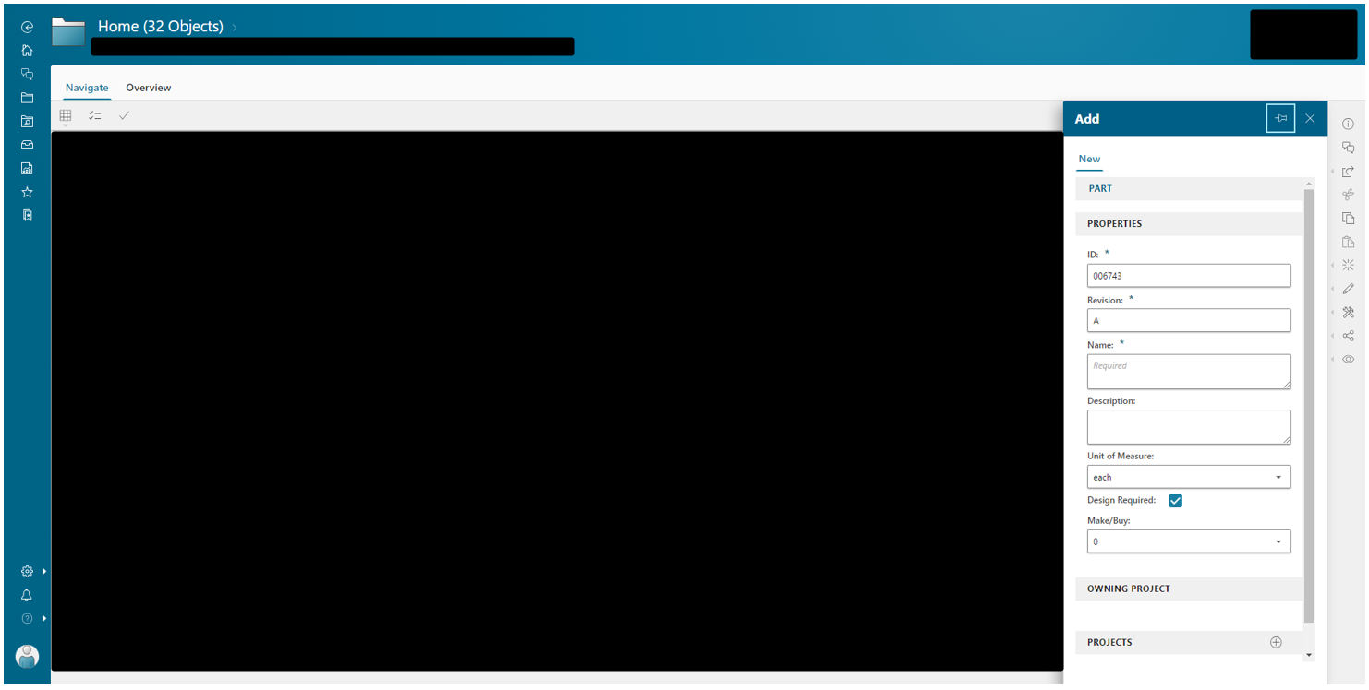
Go, change the world
RV College of
Engineering
Screen shots of Result
Creating new CAD file

Slide 36
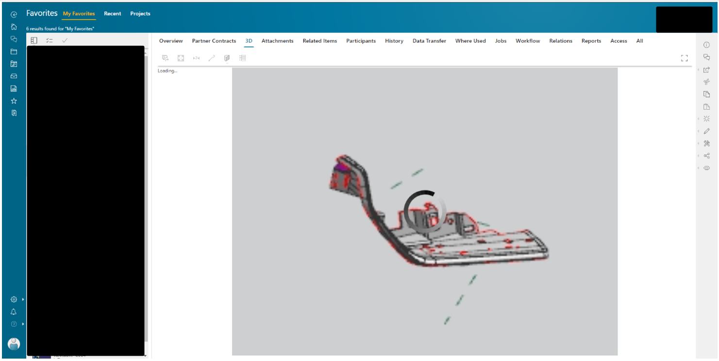
Go, change the world
RV College of
Engineering
Screen shots of Result
Creating New Design

Slide 37
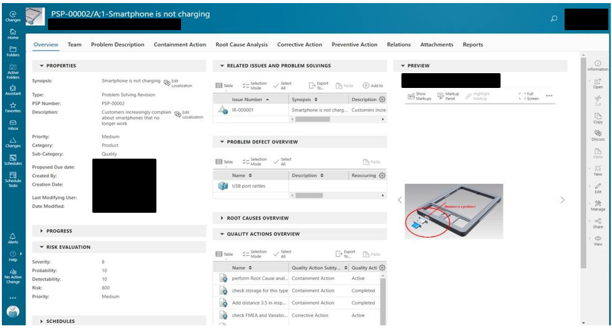
Go, change the world
RV College of
Engineering
Screen shots of Result
Quality Assurance

Slide 38
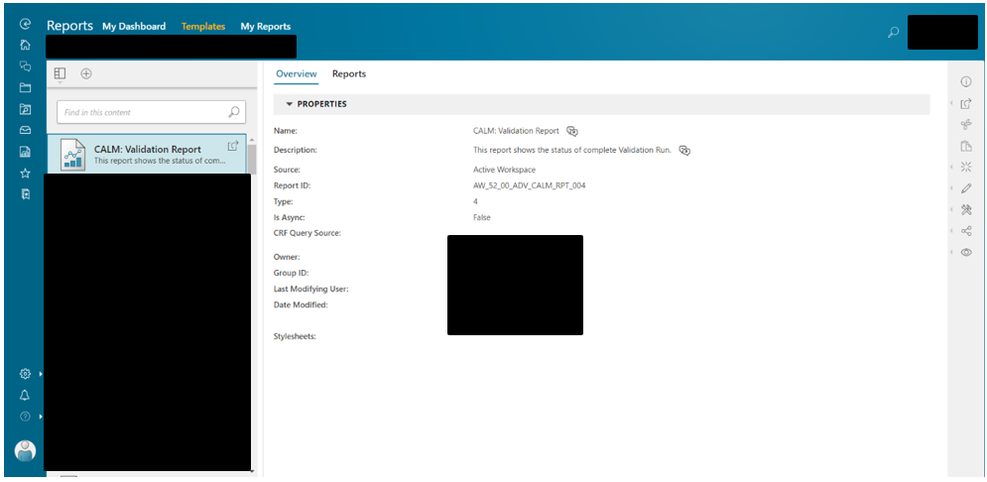
Go, change the world
RV College of
Engineering
Screen shots of Result
Reporting and Analytics

Slide 39
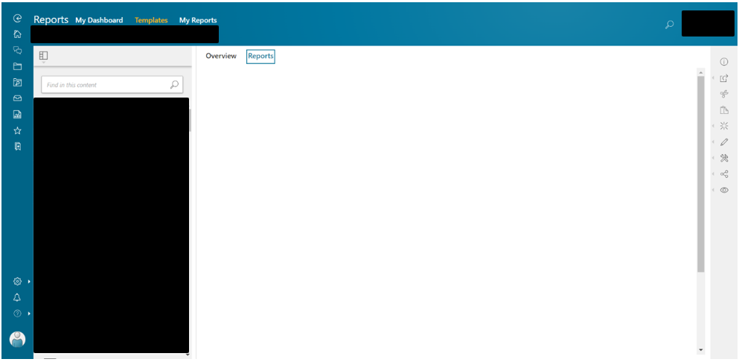
Go, change the world
RV College of
Engineering
Screen shots of Result
Report Overview

Slide 40
Go, change the world
RV College of
Engineering
Screen shots of Result
Reporting and Analytics

Slide 41
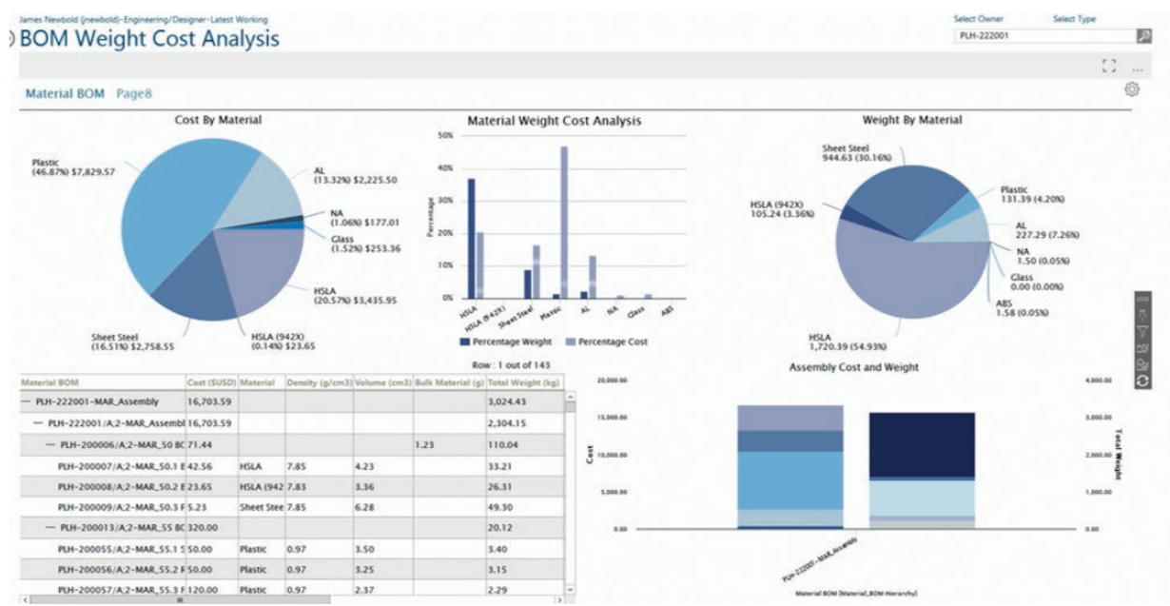
Go, change the world
RV College of
Engineering
Screen shots of Result
PLM Analytics

Slide 42
Go, change the world
RV College of
Engineering
Result and Conclusion
The results of the custom application will be adapted to the organization's particular aims and objectives. The Document Management module empowers users to efficiently manage product-related documents. From creation to modification and version control, the module ensures secure storage and easy accessibility. By implementing access control and robust search functionalities, collaboration among teams is enhanced, resulting in increased productivity and better data management.
The CAD Integration module seamlessly integrates the PLM application with CAD software, enabling smooth import, conversion, and visualization of CAD data. This synchronization fosters collaboration between design teams and ensures accuracy in product design and development. By facilitating a cohesive interface with CAD applications, the module promotes innovation, reduces errors, and expedites design processes.
The Quality Assurance module focuses on maintaining product quality through inspections, audits, and non-conformance control. The module records test results, facilitates compliance tracking, and identifies quality issues promptly. By prioritizing product quality, the module enhances customer satisfaction and fosters a culture of continuous improvement within the organization.
The Report & Analytics module empowers users to gain insights through the generation of comprehensive reports and visualizations. Customizable report templates cater to specific needs, while data aggregation and visualization tools aid in analysing product data effectively. These reports support decision-making, process improvement, and strategic planning, contributing to enhanced product development and overall business success.

Slide 43
Go, change the world
RV College of
Engineering
Future work
The PLM application might benefit from the incorporation of cutting-edge technology like artificial intelligence (AI) and machine learning (ML). Intelligent document categorization and automated quality assurance checks are only two examples of procedures that may be optimised and automated using AI and ML.’
Improving the application's flexibility and scalability may prove to be a worthwhile future improvement. This involves making sure the programme can manage increasing volumes of data and the expanding expectations of users.

Slide 44
Go, change the world
References
[1] Rajkumar Roy and David Baxter, "Product-service systems", Journal of Manufacturing Technology Management, vol. 20, pp. 327-328, 2004. https://www.researchgate.net/publication/239795242_Status_review_and_research_strategies_on_product-service_systems
[2] Robèrt Karl Henrik, "Tools and concepts for sustainable development how do they relate to a general framework for sustainable development and to each other?", Journal of Cleaner Production, vol. 8, pp. 243-254, 2000. https://www.sciencedirect.com/science/article/abs/pii/S0959652600000111
[3]B. Nattrass, The Natural Step: Corporate Learning and Innovation for Sustainability, 1999. https://web.stanford.edu/class/me221/readings/NaturalStepOverview
[4] Guo Gang, Yu Chenglong and Liu Fei, Connotation and Technology Architecture of Product Lifecycle Management, China Mechanical Engineering,2004,06, pp.512-515. https://www.ijert.org/reviewing-product-lifecycle-management-through-definitionstructure-analysis-strategies-implementation-and-applicationdsasia
[5]CIMdata, "Product Lifecycle Management, Empowering the Future of Business", www.cimdata.com, 200 https://www.academia.edu/28684633/Product_Lifecycle_Management_State_of_the_Art_and_Future_Perspectives
[6]European Commission. (2007, Jul 02). Economic reforms and competitiveness: key messages from the European Competitiveness Report 2006. https://op.europa.eu/en/publication-detail/-/publication/231e7f69-4cb9-4bbb-aef3-eb965d255281

Slide 45
Go, change the world
[7]Business Week online. (2007, Jul 02). The china price. [Online]. http://www.businessweek.com/magazine/content/04_49/b391 1401.htm.
[8]CIMD data Inc, "Product lifecycle management," Michigan: CIM data Inc., 2001. https://www.mdpi.com/2411-9660/6/5/88
[9] Research on PLM System Architecture Model and Process . https://dl.acm.org/doi/abs/10.1109/ICIE.2009.129
[10] Success determinants to Product Lifecycle Management (PLM) performance
https://www.researchgate.net/publication/325853184_Success_determinants_to_Product_Lifecycle_Management_PLM_performance
[11] Research on Integration Technology for Product Lifecycle Management System , https://dl.acm.org/doi/abs/10.5555/1172965.1173615
[12] B. Johnson et al., "Customizable PLM Solutions for Small and Medium-Sized Enterprises" Journal of Engineering Visualization, 2023
[13] C. Lee et al., "Adaptive and Agile Customization in PLM Systems" Journal of Information Security, 2021
[14] D. Brown et al., "Integration of Custom Applications with PLM Systems: Challenges and Solutions" Journal of Product Lifecycle Management, 2022

Slide 46
[15] K. Anderson et al., "Agile Development of Custom PLM Applications: Lessons Learned from Industry Projects” Journal of Sustainable Engineering, 2021
[16] L. Chen et al., "Custom PLM Applications for Supply Chain Collaboration in Global Manufacturing" International Journal of Mass Customization, 2021
[17] M. Johnson et al., "Data Integration Challenges in Custom PLM Solutions: A Systematic Review" IEEE Transactions on Engineering Management, 2023
[18] N. Wilson et al., "Exploring the Benefits and Challenges of Cloud-Based Custom PLM Applications” Journal of Concurrent Engineering, 202
[19] P. Thompson et al., "User Acceptance of Customized PLM Systems: Factors Influencing Adoption” Neural Computing and Applications, 2021
[20] Q. Davis et al., "Security and Privacy Considerations in Custom PLM Applications" International Journal of Advanced Manufacturing Technology, 2021
[21] R. Garcia et al., "Economic Analysis of Customization Options in PLM Implementations" Journal of Engineering Visualization, 2023
[22] S. Turner et al., "Custom PLM Applications for Product Data Visualization and Simulation" International Journal of Service Science, Management, Engineering, and Technology, 2022
[23] T. Mitchell et al., "Impact of Custom PLM Applications on Organizational Processes and Workflows" Journal of Data Integration and Management, 2022
[24] V. Patel et al., "Integration of AI and Machine Learning in Custom PLM Solutions: Current Trends and Future Directions" Journal of Engineering Visualization, 2023

Slide 47
THANKYOU

